Slide 1

SOFTWARE ENGINEERING
Week 5
System Modeling and Requirements Engineering

Slide 2
Agenda
System Engineering
Requirements Engineering
Requirement Engineering Processes

Slide 3

System Engineering
System Engineering
Requirements Engineering
Requirement Engineering Processes
The Case Study

Slide 4
System Engineering
Elements of a computer-based system
Software
Hardware
People
Database
Documentation
Procedures
Systems
A hierarchy of macro-elements

Slide 5
The Hierarchy

Slide 6
Requirements Engineering
System Engineering
Requirements Engineering
Requirement Engineering Processes
The Case Study

Slide 7
Requirement Engineering
The process of establishing the services that the customer requires from a system and the constraints under which it operates and is developed.
The requirements themselves are the descriptions of the system services and constraints that are generated during the requirements engineering process.

Slide 8
Types of Requirement
User requirements
Statements in natural language plus diagrams of the services the system provides and its operational constraints. Written for customers.
System requirements
A structured document setting out detailed descriptions of the system’s functions, services and operational constraints. Defines what should be implemented so may be part of a contract between client and contractor.

Slide 9
User and System Requirements

Slide 10
Users of Requirements

Slide 11
Functional and Non-functional Requirements
Functional requirements
Statements of services the system should provide, how the system should react to particular inputs and how the system should behave in particular situations.
May state what the system should not do.
Non-functional requirements
Constraints on the services or functions offered by the system such as timing constraints, constraints on the development process, standards, etc.
Often apply to the system as a whole rather than individual features or services.
Domain requirements
Constraints on the system from the domain of operation
Notes:
EXAMPLE FUNC REQ: Calculate the discount at the rate of 14% for a customer spending amount
o Number of significant digits to which accuracy should be maintained in all numerical calculations is 4
o A book can be deleted from the Library Management System by the Database Administrator only
NONFUNC REQ: The response time of the system should always be less than 5seconds
o The software should be developed using C language on a UNIX based system
o Experienced officers should be able to use all the system functions after a total training of two hours. After this training, the average number of errors made by experienced officers should not exceed two per day

Slide 12
Types of Non-functional Requirements

Slide 13
Requirements Specification
The process of writing down the user and system requirements in a requirements document.
User requirements have to be understandable by end-users and customers who do not have a technical background.
System requirements are more detailed requirements and may include more technical information.
The requirements may be part of a contract for the system development
It is therefore important that these are as complete as possible.

Slide 14
Guidelines For Writing Requirements
Invent a standard format and use it for all requirements.
Assign a unique number and source (mostly people) for each requirement.
Use language in a consistent way. Use shall for mandatory requirements, should for desirable requirements.
Use text highlighting to identify key parts of the requirement.
Avoid the use of computer jargon.
Include an explanation (rationale) of why a requirement is necessary.

Slide 15
An Example Requirement Document
Click here for an example requirements document.

Slide 16
Requirements Engineering Processes
System Engineering
Requirements Engineering
Requirements Engineering Processes
The Case Study

Slide 17
Requirements Engineering Processes
Inception—ask a set of questions that establish …
basic understanding of the problem
the people who want a solution
the nature of the solution that is desired, and
the effectiveness of preliminary communication and collaboration between the customer and the developer
Elicitation—elicit requirements from all stakeholders
Elaboration—create an analysis model that identifies data, function and behavioral requirements
Negotiation—agree on a deliverable system that is realistic for developers and customers
Specification—can be any one (or more) of the following:
A written document
A set of models
A formal mathematical
A collection of user scenarios (use-cases)
A prototype
Validation—a review mechanism that looks for
errors in content or interpretation
areas where clarification may be required
missing information
inconsistencies (a major problem when large products or systems are engineered)
conflicting or unrealistic (unachievable) requirements.
Requirements management

Slide 18
A Spiral View Of The Requirements Engineering Process

Slide 19
Problems Of Requirements Analysis
Stakeholders don’t know what they really want.
Stakeholders express requirements in their own terms.
Different stakeholders may have conflicting requirements.
Organisational and political factors may influence the system requirements.
The requirements change during the analysis process. New stakeholders may emerge and the business environment may change.

Slide 20
Use Cases
Use case diagrams are used to visualize, specify, construct, and document the (intended) behavior of the system, during requirements capture and analysis.
Provide a way for developers, domain experts and end-users to Communicate.
Serve as basis for testing.
Main authors: Booch, Rumbaugh, and Jacobson
The Object Management Group (OMG) is responsible for standardization. (www.omg.org)
Current version is UML 2.0

Slide 21
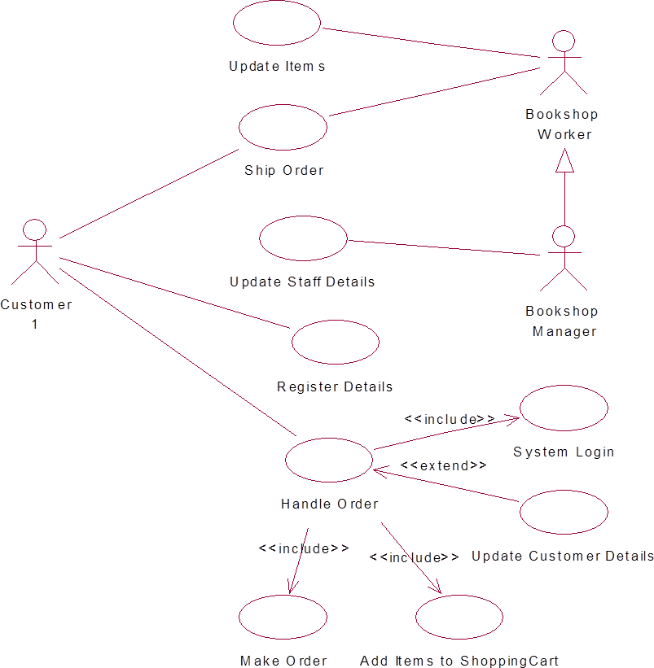
Example : Use Case Diagram
Notes:
AN ACTOR NEED NOT TO BE A HUMAN BEING. EXAMPLE:
An e-commerce information system has to interact with the credit card company information system
The credit card company information system is an actor from the viewpoint of the e-commerce information system
The e-commerce information system is an actor from the viewpoint of the credit card company information system

Slide 22
Example : Use Case (Money Withdraw) - I
Use Case: Withdraw Money
Author: ZB
Date: 1-OCT-2004
Purpose: To withdraw some cash from user’s bank account
Overview: The use case starts when the customer inserts his credit card into the system. The system requests the user PIN. The system validates the PIN. If the validation succeeded, the customer can choose the withdraw operation else alternative 1 – validation failure is executed. The customer enters the amount of cash to withdraw. The system checks the amount of cash in the user account, its credit limit. If the withdraw amount in the range between the current amount + credit limit the system dispense the cash and prints a withdraw receipt, else alternative 2 – amount exceeded is executed.
Cross References: R1.1, R1.2, R7

Slide 23
Example : Use Case (Money Withdraw) - II
Actors: Customer
Pre Condition:
The ATM must be in a state ready to accept transactions
The ATM must have at least some cash on hand that it can dispense
The ATM must have enough paper to print a receipt for at least one transaction
Post Condition:
The current amount of cash in the user account is the amount before the withdraw minus the withdraw amount
A receipt was printed on the withdraw amount
The withdraw transaction was audit in the System log file

Slide 24
Example : Use Case (Money Withdraw) - III
Typical Course of events:
Actor Actions | System Actions
1. Begins when a Customer arrives at ATM
2. Customer inserts a Credit card into ATM | 3. System verifies the customer ID and status
5. Customer chooses “Withdraw” operation | 4. System asks for an operation type
7. Customer enters the cash amount | 6. System asks for the withdraw amount
 | 8. System checks if withdraw amount is legal
 | 9. System dispenses the cash
 | 10. System deduces the withdraw amount from account
 | 11. System prints a receipt
13. Customer takes the cash and the receipt | 12. System ejects the cash card

Slide 25
Example : Use Case (Money Withdraw) - IV
Alternative flow of events:
Step 3: Customer authorization failed. Display an error message, cancel the transaction and eject the card.
Step 8: Customer has insufficient funds in its account. Display an error message, and go to step 6.
Step 8: Customer exceeds its legal amount. Display an error message, and go to step 6.
Exceptional flow of events:
Power failure in the process of the transaction before step 9, cancel the transaction and eject the card

Slide 26
What is a User Story?
Simple, Clear, short description of customer valued functionality
User Stories are NOT part of the Scrum framework
User Stories are an eXtreme Programming technique
This may optionally be used to capture Product Backlog Items
The Product Backlog is the Scrum Artifact
User Stories capture Who, What and Why of any requirement
3Cs – Card, Conversation, Confirmation
Conversation rather than documentation

Slide 27
Leveraging User Roles and Personas
Write story from user’s perspective
Understand the user’s goal for the story
Understand the user’s value from the story
Use human users
Avoid generic “as a user” or “as a customer”
If you have identified Personas, the story could be written from the point of view of this character/user
Notes:
Personas – can be used for outliners
Don’t use the term user or customer, those are very generic, e.g. use frequent flyer.

Slide 28
User Story Template
Title:
Priority:
As a [type of user], I want [goal] so that
[Value]
Notes:
Assumptions:
Constraints:
Estimate:
Notes:
Write them down, be it Notes, Constraints, Risks, Assumptions
No harm and it helps in prioritization, estimation

Slide 29
User Story Example
Checkout Using Credit Card
Priority: 25
As a book shopper, I can checkout using my credit card
So that I can purchase a selected book.
Notes: Support mc, visa, amex
Constraints: Must use SBI payment gateway
Estimate: 13pts
Notes:
UX has to be mentioned in the requirements

Slide 30
Acceptance Criteria
Given [context]
When [some event]
Then [outcome]
Notes:
Behavior Driven Development
As a good P.O. you need to have Acceptance Criteria for every user story

Slide 31
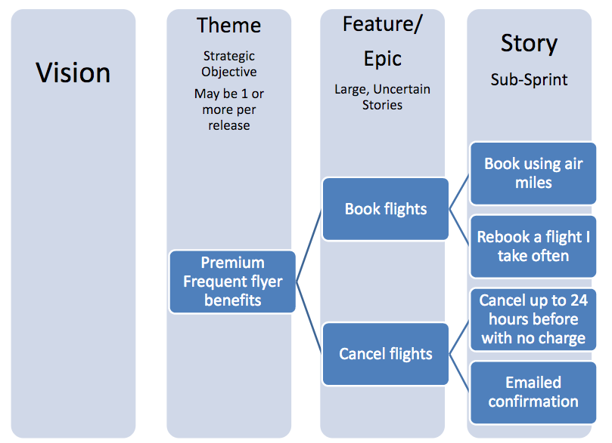
Feature/Epic/User Story

Slide 32
User Story Examples
As a user I want emails with attachments to go faster so that I can work more efficiently
As a user I want to cancel a reservation so that I avoid being charged full rate

Slide 33
Tools For Requirements
OSRMT – Open Source Requirements Management Tool www.sourceforge.net/projects/osrmt
EasyRM – Cybernetic Intelligence www.eary-rm.com
Rational Requisite Pro www.rational.com
OnYourMark - Omni-Vista www.omni-vista.com
RTM – Integratd Chipware www.chipware.com

Slide 34
Wrap-up
This week we present
System Engineering: How to model and understand the overall components of a software system
Requirements Engineering: How to manage and acquire the needs of customer
Requirement Process: What phases should be applied in effectively gathering requirements.

Slide 35
Next Week
We will introduce object oriented and classical approaches in Requirements Analysis!!!

